Slide 1

DATA SCIENCE AND MACHINE LEARNING
DLYA SKILL ACQUISITION BOOTCAMP 3.0
THE ANALYSIS OF INFLATION AND ECONOMIC GROWTH OF LARGE ECONOMIES IN
SUB-SAHARAN AFRICA
A CAPSTONE PROJECT PRESENTATION
BY GROUP 13
ANALYSTS
OBIOMA OGBUOKIRI
OLANREWAJU SANNI ALABA
AMINAT YEWANDE ADEDEYI

Slide 2
contents
01
Introduction
02
Methodology
03
Results
04
Conclusion

Slide 3
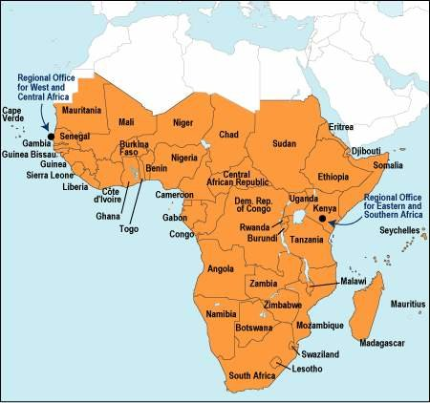
01
INTRODUCTION
Sub-Saharan Africa
Sub-Saharan Africa is one of the six major regions in the world. It comprises forty-nine countries.

Slide 4
Introduction
The lowest total gross domestic product (GDP), which is a measure of all goods and services generated in a nation or region, is found in Sub-Saharan Africa
This region, like other parts of the world, in recent times has experienced rise in inflation rate which may hamper economic growth, and generates volatility in the ER.

Slide 5
01
Introduction
This study seeks to:
03
Make an attempt on predictive model that will be able to forecast future inflation rate
02
Ascertain the relationship between the inflation rate and GDP growth in this region
•Investigate how and to what extent inflation affects or influences economic growth in Sub-Saharan Africa..
01

Slide 6
METHODOLOGY
02

Slide 7
02
YOUR TITLE
Data source
Both the inflation rate and GDP used for this were obtained from www,kaggle,com
Data Cleaning
Import the necessary libraries
Read the files using pandas
Drop the columns that are irrelevant to the analysis
Rename ‘Country Name’ column as Country'
Check that the remaining columns are useful for the analysis

Slide 8
02
Methodology
Data cleaning
Analysis
Create a dataframe of just the Sub-Sahara African countries
transpose the Sub_Saharan_Africa_GDP dataframe to have the countries as columns. This will help us plot a bar graph of the average GDP.
The series extraction of the Average GDP of the Countries
1.Calculate the max,min, and mean of both inflation rate and GDP of the five countries
Analysis
Data cleaning
Comparison of the inflation rate and GDP growth in different countries
Plot a graph of GDP of all the countries in Sub-Saharan Africa
Create a dataframe of just the five largest Sub-Saharan African economies using the Inflation rate.
Transpose the Sub_Saharan_Africa_Inflation rate dataframe to have the countries as columns.

Slide 9
02
Methodology
Model
1.Create a dataframe of one of largest Sub-Saharan African economies using the Inflation rate.
Model
Model
2.Transpose the dataframe to have the country as column.
4.PACF and ACF plots
Model
Model
3.Test the stationarity of the series using ADF statistic
5. Building of the model and model accuracy

Slide 10
RESULTS
03

Slide 11
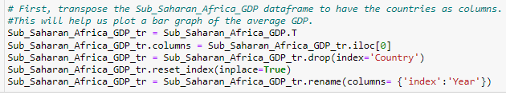
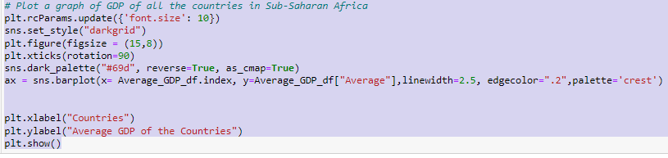

Slide 12
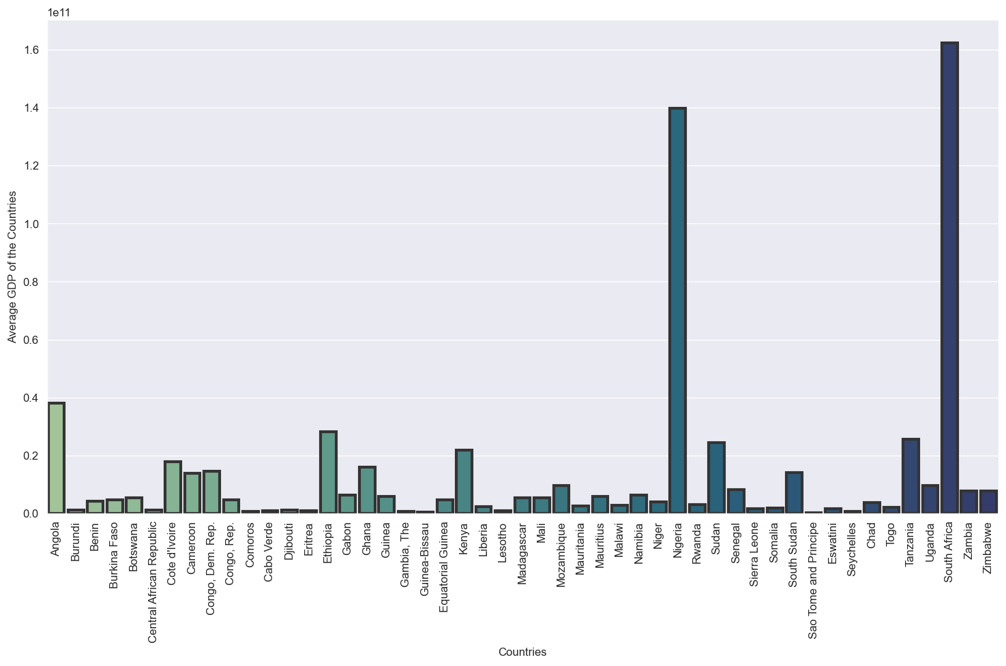
03
RESULTS
Figure 1. Bar plot of Average GDP of the Sub Saharan African Region per Country

Slide 13
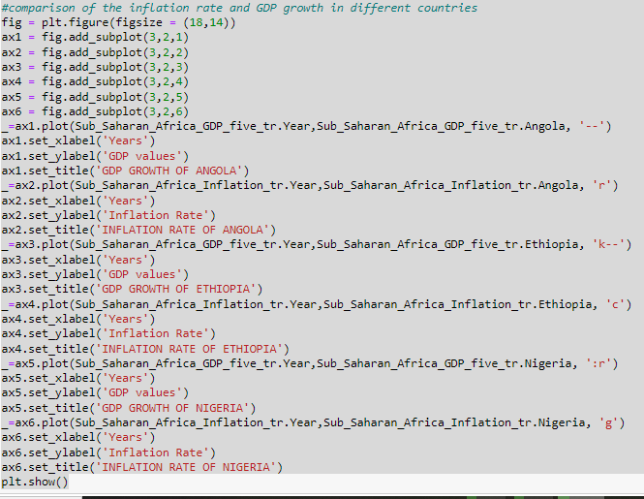
Comparison of Inflation Rate and GDP growth in five larger Economies of Sub-Saharan Africa

Slide 14
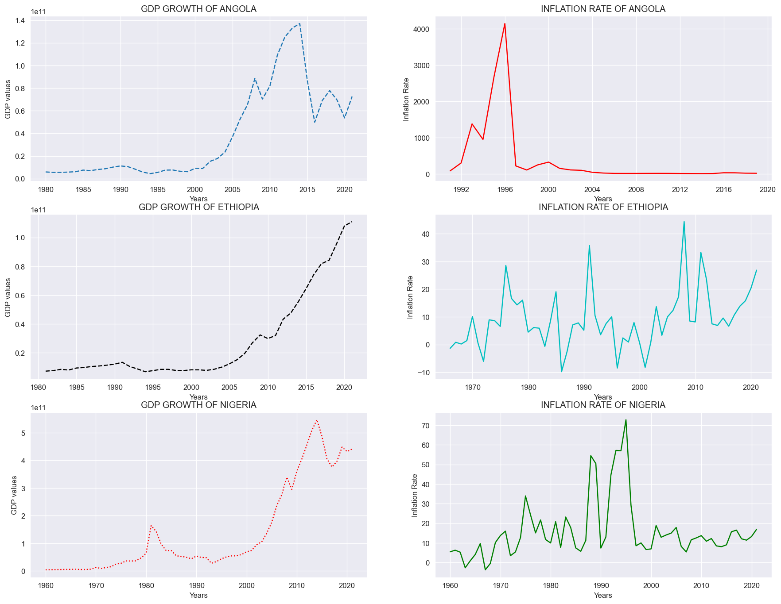
03
Results
Add your words here,
according to your need to draw the text box size.
Please read the instructions and more work at the end of the manual template.
Add your words here,
according to your need to draw the text box size.
Please read the instructions and more work at the end of the manual template.
Figure 2: Comparison of Inflation rate and GDP growth of the five major economies in Sub-Saharan Africa.

Slide 15
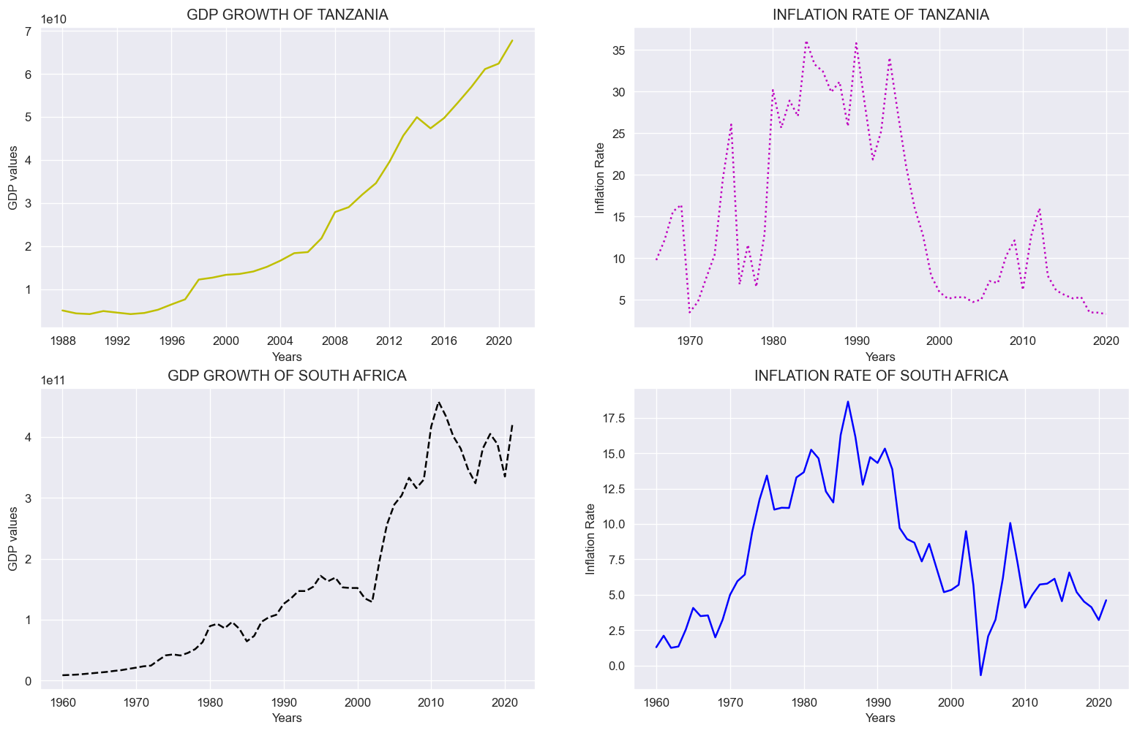
03
Results
01
Keyword
Keyword
04
Figure 3: Comparison of Inflation rate and GDP growth of the five major economies in Sub-Saharan Africa. cont’d

Slide 16
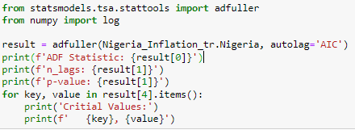
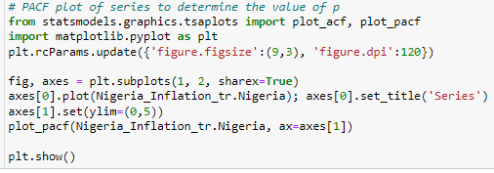
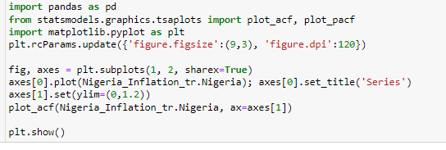

Slide 17
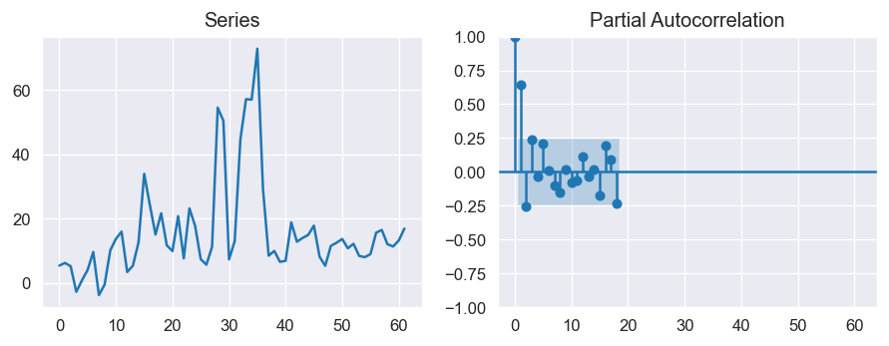
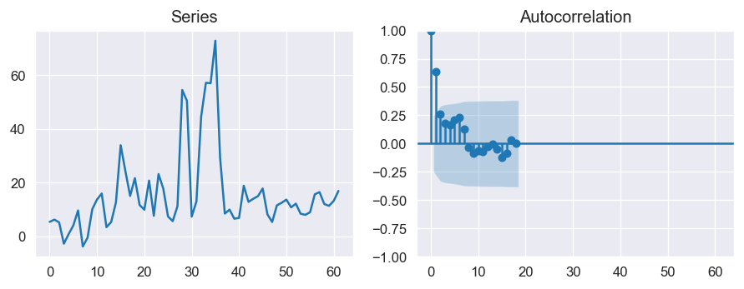
Testing for the Stationarity and choice of Model parameters
03
Result
Table 1: Augmented Dickey Fuller test (ADF Test)
ADF Statistic: | -4.145
p-value | 0.0008
Critial Values: 1% | -3.54
5% | -2.91
10% | -2.59
Figure 4: Partial Autocorrelation Function(PACF) plot
Figure 5: Autocorrelation Function(ACF) plot

Slide 18
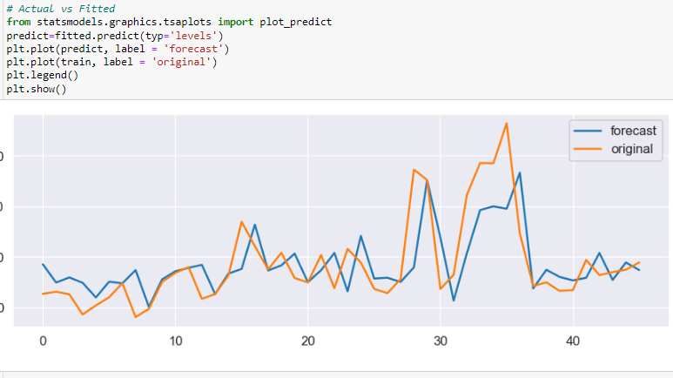
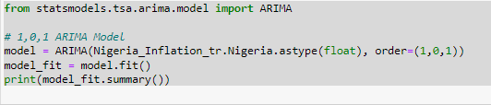
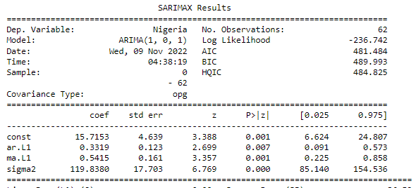
Building ARIMA model
03
Results

Slide 19
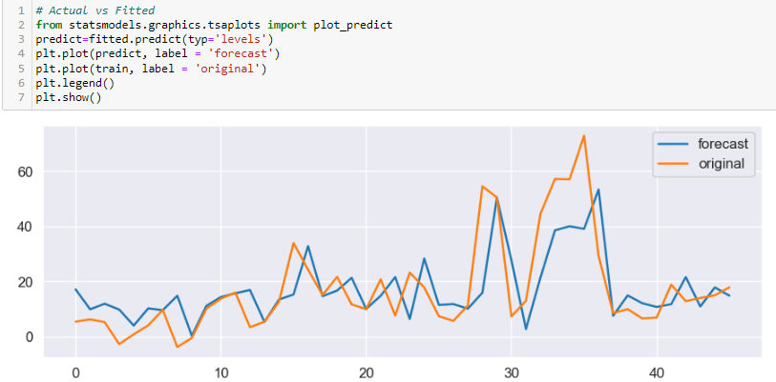


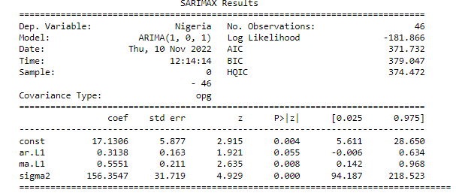
Cross Validation: Using train and test data
03
Results
Keyword
Keyword
YOUR TITLE
Keyword
Keyword

Slide 20
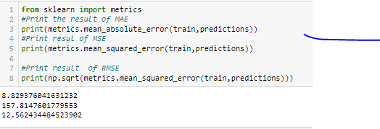
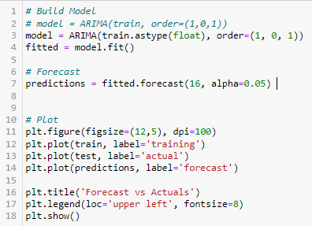
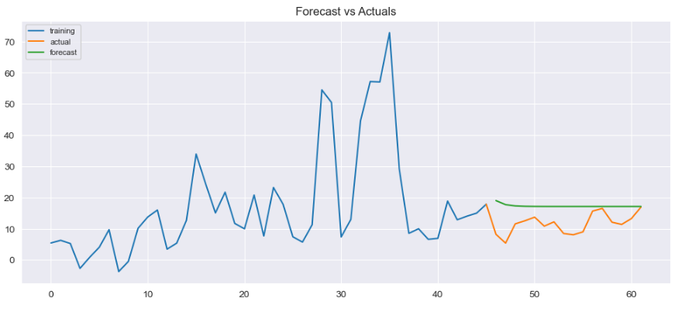
03
Results
Add your words here,according to your need to draw the text box size.
Add your words here,according to your need to draw the text box size.

Slide 21
CONCLUSION

Slide 22
Inflation rates and GDP growth are negatively correlated over a long period, although the negative impact on the economy is temporary.
The ARIMA model has shown that inflation is one of the macroeconomic variables that affect GDP growth and can exert a negative impact on economic growth for all countries in the sample.
Therefore, inflation can be used to predict economic growth for all countries in the sample.
Add your words here,according to your need to draw the text box size.
Add your words here,according to your need to draw the text box size.

Slide 23
THANK YOU!

